Slide 1
Black Box Testing Decision Table Testing
Prepared by Chala Urgessa

Slide 2
Decision Table Testing
Boundary value analysis and equivalence class partitioning methods do not consider combinations of input conditions. These consider each input separately.
There may be some critical behavior to be tested when some combinations of input conditions are considered.
A decision table is a good way to deal with combinations of things (e.g. Inputs).
It has the specialty of considering complex combinations of input conditions and resulting actions. Decision tables obtain their power from logical expressions.
Each operand or variable in a logical expression takes on the value, TRUE or FALSE.
决策表通过逻辑组合考虑复杂的输入条件，有效地揭示了不同输入组合下的行为结果，填补了边界值分析和等价类划分在处理条件组合时的空缺。

Slide 3
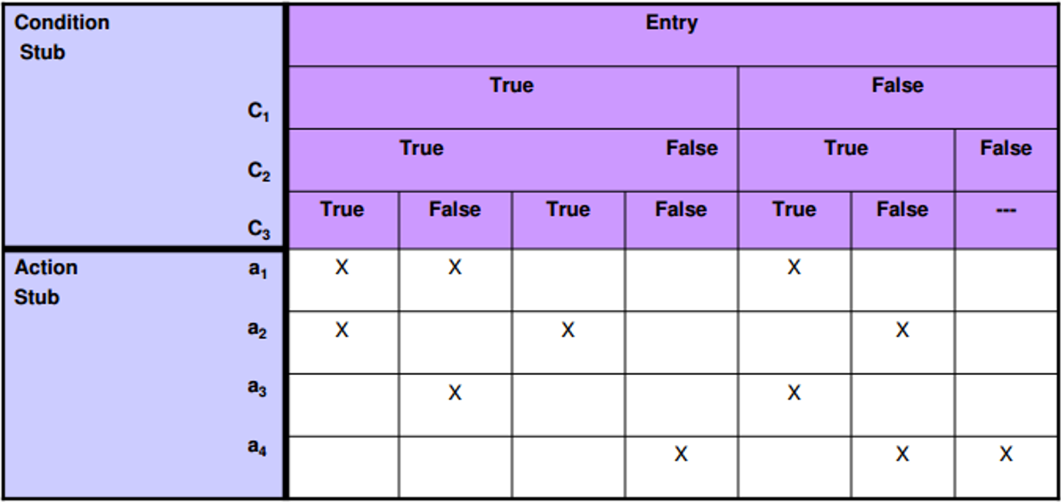
Decision Table Testing
Condition stub It is a list of input conditions for which the complex combination is made.
Action stub It is a list of resulting actions which will be performed if a combination of input condition is satisfied.
Notes:
When the condition entry takes only two values—TRUE or FALSE, then it is called Limited Entry Decision Table. When the condition entry takes several values, then it is called Extended Entry Decision Table. In limited entry decision table, condition entry, which has no effect whether it is True or False, is called a Don’t-Care state or immaterial state (represented by I). The state of a don’t-care condition does not affect the resulting action.
Action entry It is the entry in the table for the resulting action to be performed when one rule (which is a combination of input condition) is satisfi ed. ‘X’
denotes the action entry in the table. When the condition entry takes only two values—TRUE or FALSE, then it is called Limited Entry Decision Table. When the condition entry takes several values, then it is called Extended Entry Decision Table. In limited entry decision table, condition entry, which has no effect whether it is True or False, is called a Don’t-Care state or immaterial state (represented by I). The state of a don’t-care condition does not affect the resulting action.
Action entry It is the entry in the table for the resulting action to be performed when one rule (which is a combination of input condition) is satisfi ed. ‘X’ denotes the action entry in the table.

Slide 4
Decision Table Testing
Step 1: Select a Subsystem/Function (选择子系统/功能): Identify a part that responds to input combinations. Simplify complex conditions into manageable groups. (识别对输入组合有反应的部分。简化复杂条件成可管理的组。)
Step2: Build Decision Table (建立决策表): Outline conditions with True/False states. Each row shows a distinct combination of inputs. (概述具有真/假状态的条件。每行显示输入的不同组合。)
Step 3: Define Outcomes (定义结果): Assign expected responses for each input set, ensuring thorough testing and pinpointing of issues. (为每组输入指定预期响应，确保彻底测试和准确发现问题。)

Slide 5
Example 1: Decision Table Testing
Credit card worked example
If you are a new customer opening a credit card account, you will get a 15% discount on all your purchases today. If you are an existing customer and you hold a loyalty card, you get a 10% discount. If you have a coupon, you can get 20% off today (but it can't be used with the 'new customer' discount). Discount amounts are added, if applicable.
Draw the Decision table and design the test cases.

Slide 6
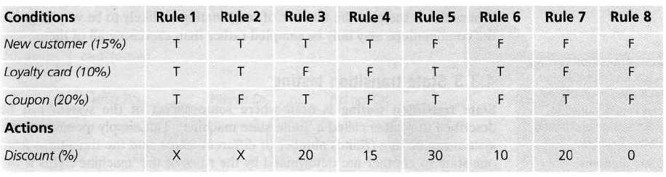
Decision Table Testing

Slide 7
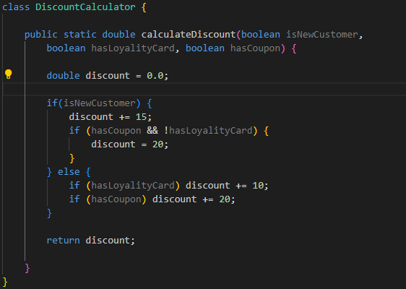
Implementation
Write the junit testing implementation

Slide 8
Example 2: Class Activity
Consider a simple program to classify a triangle. Its inputs is a triple of positive integers (say x, y, z). The program output may be one of the following words:
[Scalene; Isosceles; Equilateral; Not a triangle; Impossible]
Draw the Decision table and design the test cases.

Slide 9
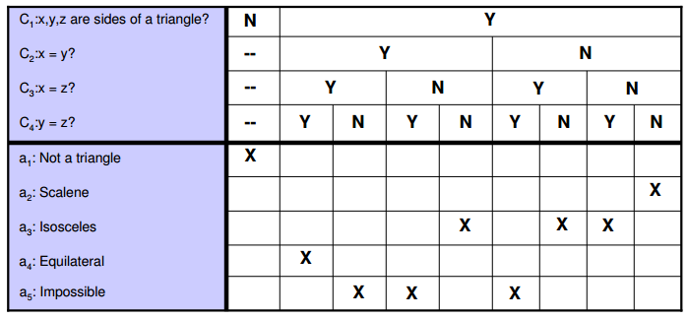
Decision Table Testing cont…
a. Decision Table

Slide 10
Decision Table Testing cont…
b. Test Cases
Test Case | x | Y | z | Output
1 | - | - | - | Not a Triangle
2 | 2 | 2 | 2 | Equilateral
3 | - | - | - | Impossible
4 | - | - | - | Impossible
5 | 2 | 2 | 1 | Isosceles
6 | - | - | - | Impossible
7 | 2 | 1 | 2 | Isosceles
8 | 1 | 2 | 2 | Isosceles
9 | 3 | 4 | 5 | Scalene

Slide 11
Example 3: Home Work
A university is admitting students in a professional course subject to the following conditions:
Marks in Java ≥ 70
Marks in C++ ≥ 60
Marks in OOAD ≥ 60
Total in all three subjects ≥ 220 OR Total in Java and C++ ≥ 150
If the aggregate mark of an eligible candidate is more than 240, he will be eligible for a scholarship course, otherwise, he will be eligible for the normal course. The program reads the marks in the three subjects and generates the following outputs:
Not eligible
Eligible for scholarship course
Eligible for normal course
Design test cases for this program using decision table testing.

